Slide 1
INFO 250 Information Visualization
8B Shiny

Slide 2
What is R Shiny?
Shiny is an R package for building interactive web applications that can execute R code on the backend.
It provides a robust web framework
Host standalone applications on a webpage
Embed interact charts in R Markdown documents
Build dashboards
R Shiny is an open-source package.
Upscale
RStudio Connect

Slide 3
Two Ways
One file
app.R
Two files
ui.R
server.R

Slide 4
Layout a sidebar and main area
Create a layout (sidebarLayout()) with a sidebar (sidebarPanel()) and main area (mainPanel()). The sidebar is displayed with a distinct background color and typically contains input controls. The main area occupies 2/3 of the horizontal width and typically contains outputs.
Arguments
sidebarPanel
The sidebarPanel() containing input controls.
mainPanel
The mainPanel() containing outputs.
position
The position of the sidebar relative to the main area ("left" or "right").
fluid
TRUE to use fluid layout; FALSE to use fixed layout.
...
Output elements to include in the sidebar/main panel.
width
The width of the sidebar and main panel. By default, the sidebar takes up 1/3 of the width, and the main panel 2/3. The total width must be 12 or less.
Usage
sidebarLayout(
sidebarPanel,
mainPanel,
position = c("left", "right"),
fluid = TRUE
)
sidebarPanel(..., width = 4)
mainPanel(..., width = 8)

Slide 5
render*() Functions
renderPlot()
renderDataTable()
renderImage()
renderText()

Slide 6
Output Functions
tableOutput
imageOutput
textOutput
plotOutput

Slide 7
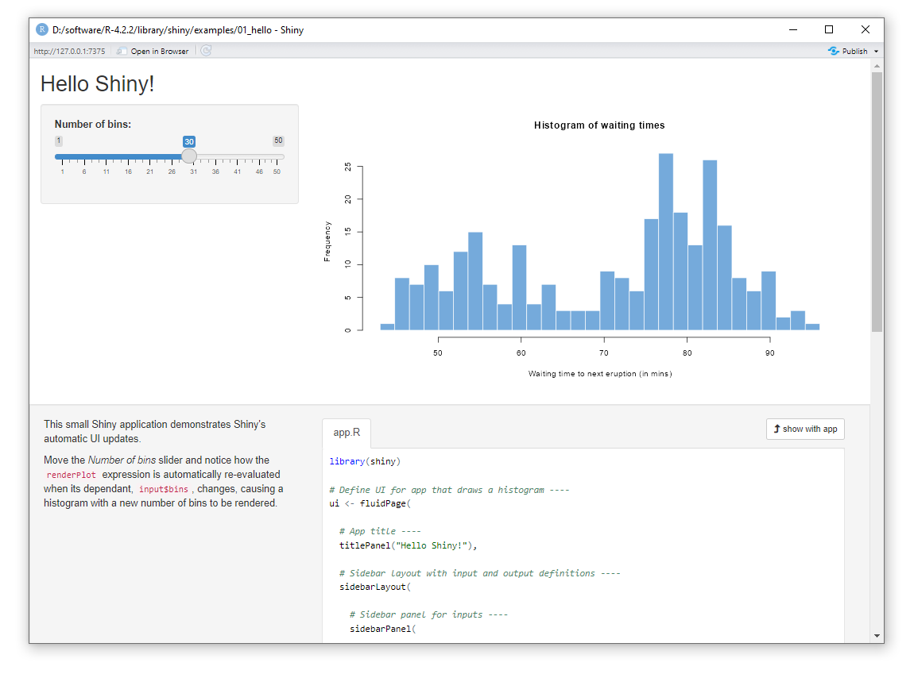
First Example
install.packages("shiny")
library(shiny)
runExample("01_hello")

Slide 8
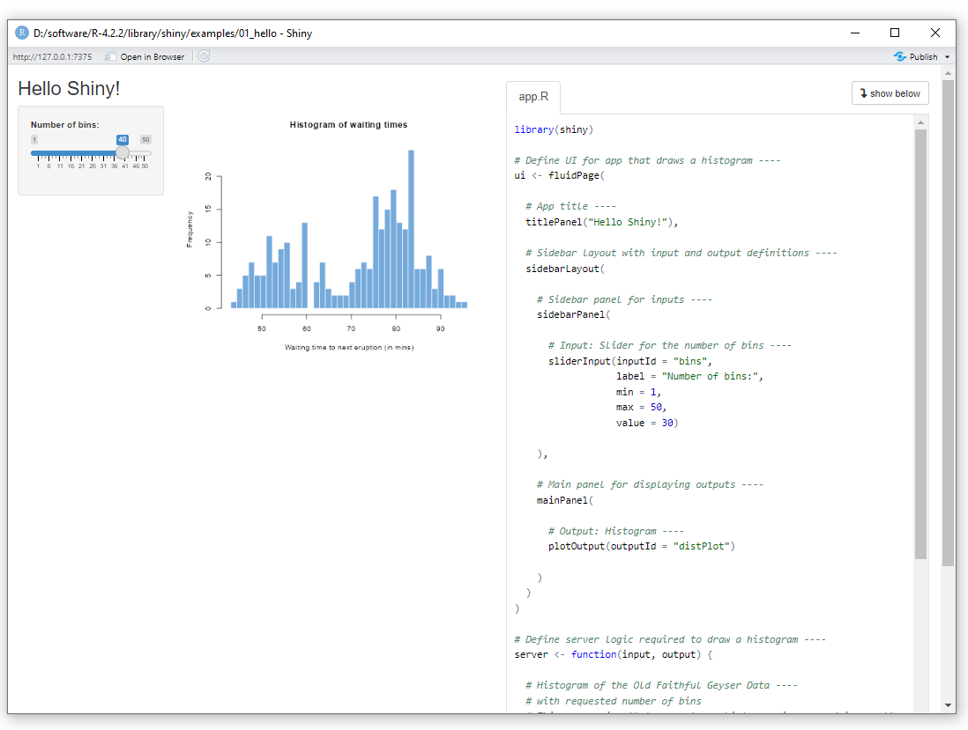
titlePanel
sidebarPanel
sliderInput
mainPanel

Slide 9
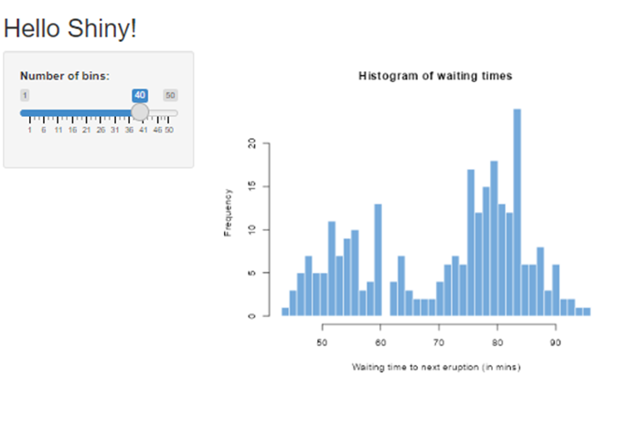
library(shiny)
# Define UI for app that draws a histogram ----
ui <- fluidPage(
# App title ----
titlePanel("Hello Shiny!"),
# Sidebar layout with input and output definitions ----
sidebarLayout(
# Sidebar panel for inputs ----
sidebarPanel(
# Input: Slider for the number of bins ----
sliderInput(inputId = "bins", label = "Number of bins:", min = 1, max = 50, value = 30)
),
# Main panel for displaying outputs ----
mainPanel(
# Output: Histogram ----
plotOutput(outputId = "distPlot")
)
)
)

Slide 10
# Define server logic required to draw a histogram ----
server <- function(input, output) {
# Histogram of the Old Faithful Geyser Data ----
# with requested number of bins
# This expression that generates a histogram is wrapped in a call
# to renderPlot to indicate that:
#
# 1. It is "reactive" and therefore should be automatically
# re-executed when inputs (input$bins) change
# 2. Its output type is a plot
output$distPlot <- renderPlot({
x <- faithful$waiting
bins <- seq(min(x), max(x), length.out = input$bins + 1)
hist(x, breaks = bins, col = "#75AADB", border = "white",
xlab = "Waiting time to next eruption (in mins)",
main = "Histogram of waiting times")
})
}
# Create Shiny app ----
shinyApp(ui = ui, server = server)

Slide 11
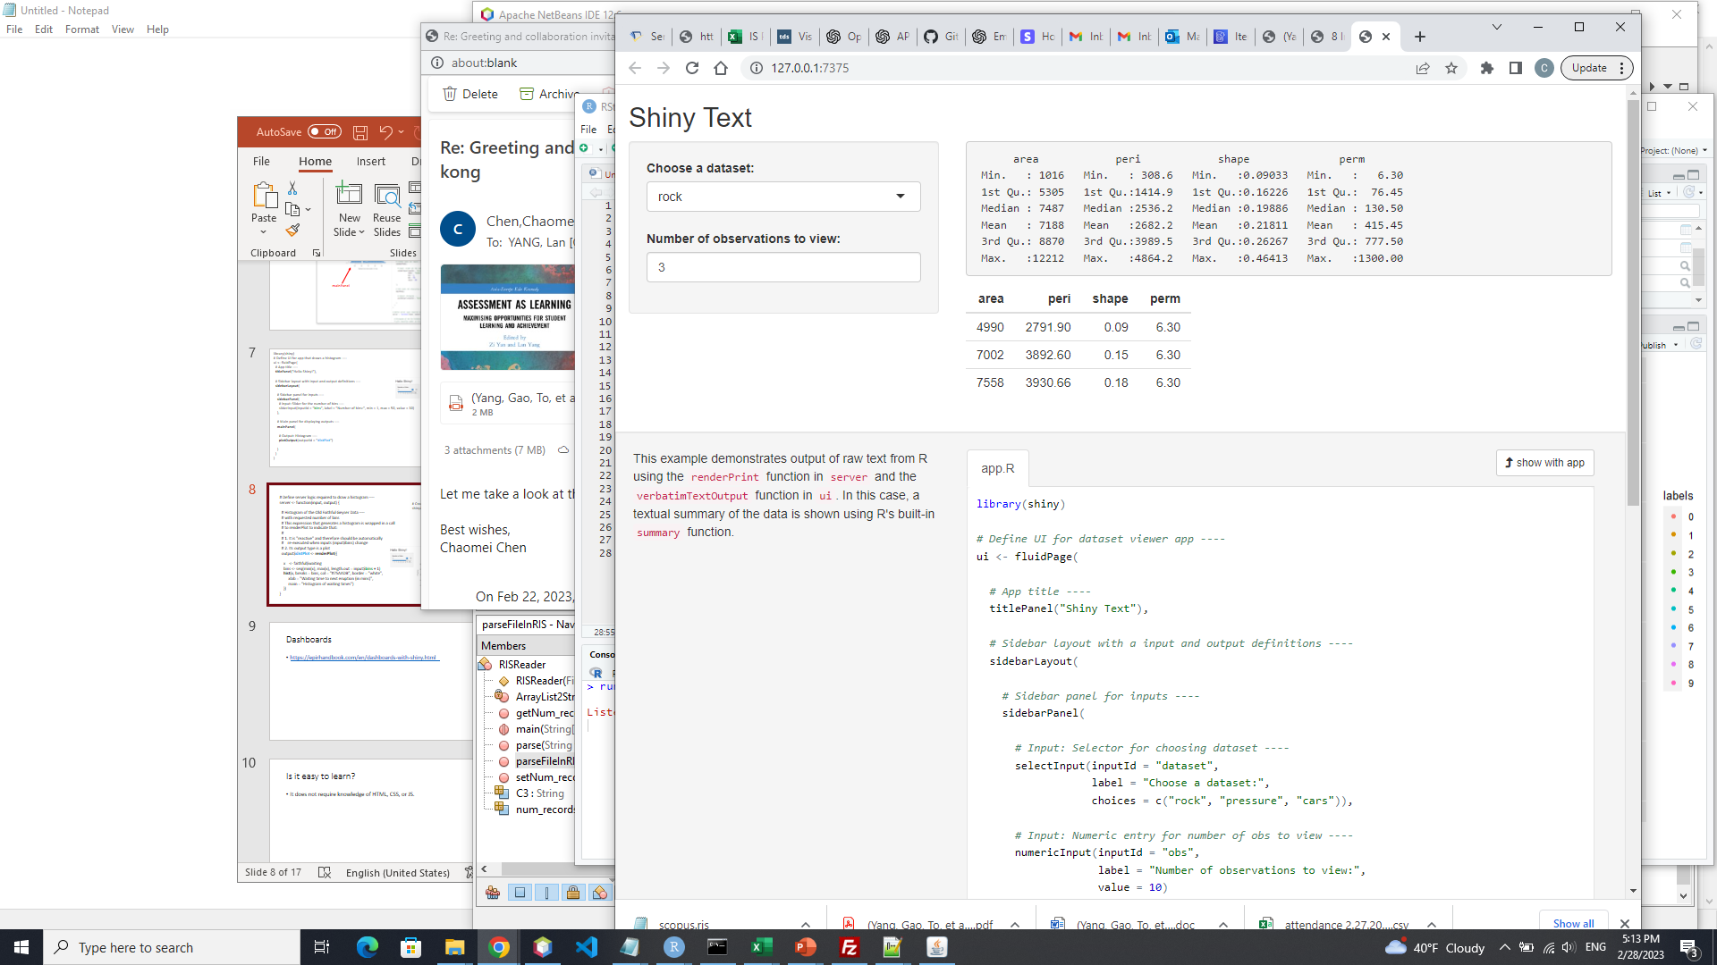
runExample("02_text")

Slide 12
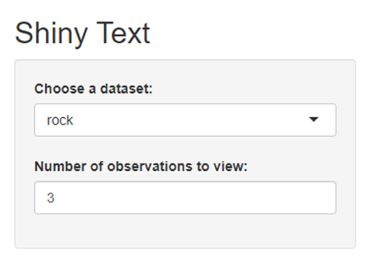
# Input: Selector for choosing dataset ----
selectInput(inputId = "dataset",
label = "Choose a dataset:",
choices = c("rock", "pressure", "cars")),
# Input: Numeric entry for number of obs to view ----
numericInput(inputId = "obs",
label = "Number of observations to view:",
value = 3)
sidebarLayout(
# Sidebar panel for inputs ----
sidebarPanel(
# Input: Selector for choosing dataset ----
selectInput(inputId = "dataset",
label = "Choose a dataset:",
choices = c("rock", "pressure", "cars")),
# Input: Numeric entry for number of obs to view ----
numericInput(inputId = "obs",
label = "Number of observations to view:",
value = 10)
),

Slide 13
mainPanel(
# Output: Verbatim text for data summary ----
verbatimTextOutput("summary"),
# Output: HTML table with requested number of observations ----
tableOutput("view")
)

Slide 14
server <- function(input, output) {
# Return the requested dataset ----
datasetInput <- reactive({
switch(input$dataset,
"rock" = rock,
"pressure" = pressure,
"cars" = cars)
})
# Generate a summary of the dataset ----
output$summary <- renderPrint({
dataset <- datasetInput()
summary(dataset)
})
# Show the first "n" observations ----
output$view <- renderTable({
head(datasetInput(), n = input$obs)
})
}

Slide 15
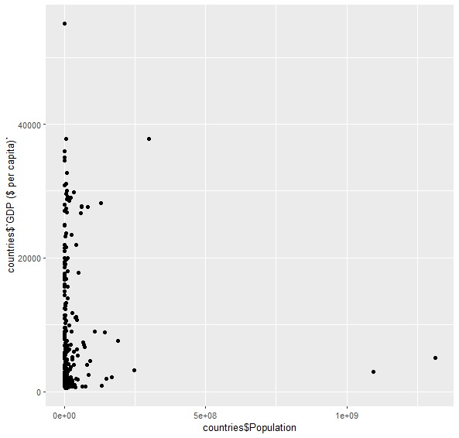
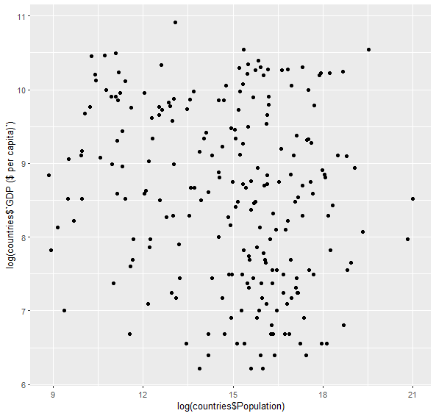
Populations x GDP
countries <-read_csv("D:\\Drexel\\Teaching\\INFO250\\week8\\countries.csv")
ggplot(countries, aes(x=log(countries$Population), y=log(countries$`GDP ($ per capita)`))) + geom_point()
Notes:
http://becomingvisual.com/rfundamentals/countries.csv

Slide 16
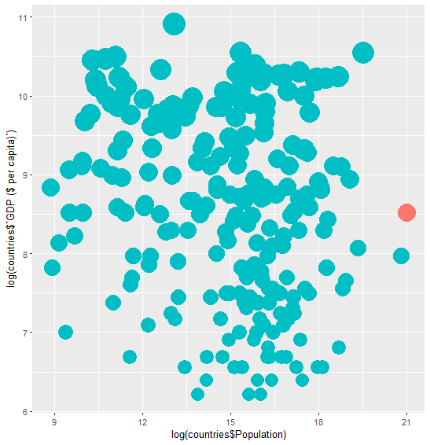
country <- “China”
ggplot(countries, aes(x=log(countries$Population), y=log(countries$`GDP ($ per capita)`), col=ifelse(countries$Country==country, "black","red"))) +
geom_point(size = log(countries$`GDP ($ per capita)`)) +
theme(legend.position = "none")

Slide 17
# Define UI for application that draws a scatterplot
ui <- fluidPage(
# Application title
titlePanel("Country Data"),
# Sidebar with a slider input for number of bins
sidebarLayout(
sidebarPanel(
selectInput("country",
"Countries",
paste(countries$Country),
selected = "China", multiple = FALSE)
),
# Show a plot of the generated distribution
mainPanel(
plotOutput("countryPlot")
)
)
)
# Define server logic required to draw a scatterplot
server <- function(input, output) {
output$countryPlot <- renderPlot({
country = input$country
ggplot(countries, aes(x=log(countries$Population), y=log(countries$`GDP ($ per capita)`), col=ifelse(countries$Country==country, "black","red"))) + geom_point(size = log(countries$`GDP ($ per capita)`)) + theme(legend.position = "none")
})
}
# Run the application
shinyApp(ui = ui, server = server)
library(shiny)
require(readr)
countries <-read_csv("D:\\Drexel\\Teaching\\INFO250\\week8\\countries.csv")

Slide 18
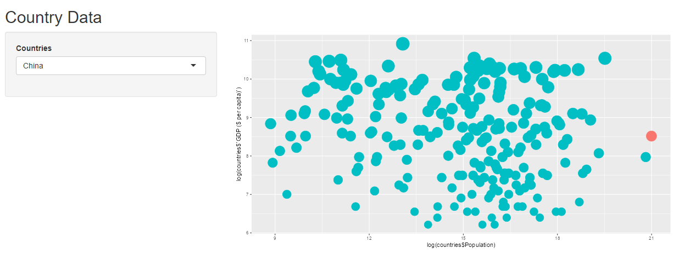
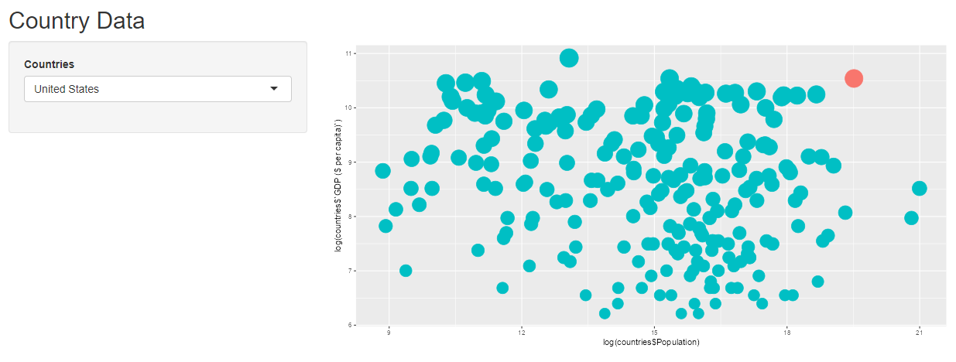

Slide 19
Publishing your app
You can publish your shiny app on the shinyapps.io website.
This is a free space for hosting your apps. However, the freemium version has several limitations.
Steps to publishing your app
Install the lastest version of the rsconnect package.
Create an account on the shinyapps.io website.
Ensure you are logged into that account.
Find your app.R file in RStudio. Open it and click on Run App.
Once the preview of the app is running select the Publish button. Select a name for your app and the relevant files to be published.
Once published, your browser should launch a page with your published app.

Slide 20
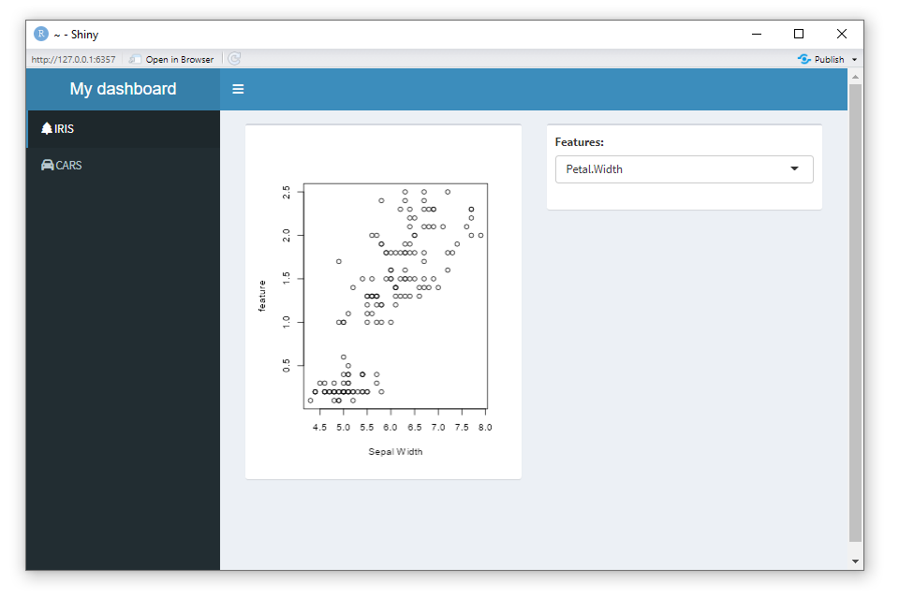

Slide 21
install.packages("Shiny")
library(shiny)
install.packages("shinydashboard")
library(shinydashboard)
ui<-dashboardPage(
dashboardHeader(title = "My dashboard"),
dashboardSidebar(
sidebarMenu(
menuItem("IRIS", tabName = "iris", icon = icon("tree")),
menuItem("CARS", tabName = "cars", icon = icon("car")) )
),
dashboardBody(
tabItems(
tabItem("iris",
box(plotOutput("correlation_plot")), box(selectInput("features","Features:", c("Sepal.Width", "Petal.Length", "Petal.Width") ) )
),
tabItem("cars", fluidPage(h1("cars")) )
)
)
)
server <- function(input,output){
output$correlation_plot <- renderPlot(
{ plot(iris$Sepal.Length,iris[[input$features]], xlab="Sepal Width", ylab = "feature") }
)
}
shinyApp(ui,server)

Slide 22
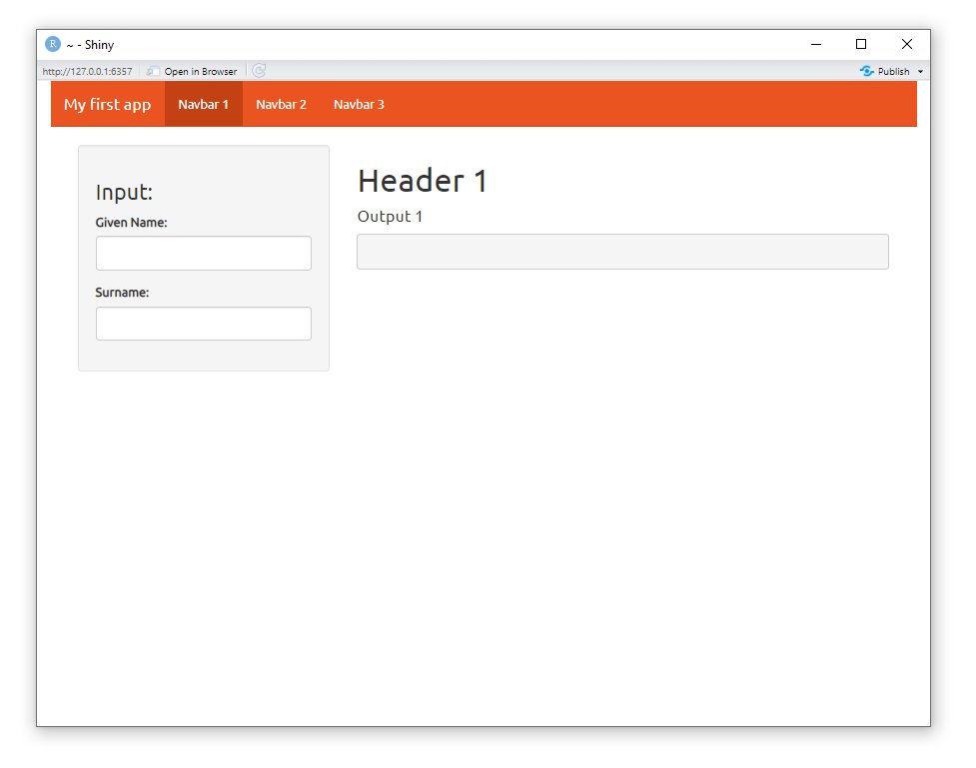
#install.packages("shiny")
library(shiny)
install.packages("shinythemes")
library(shinythemes)

Slide 23
Resources
http://becomingvisual.com/rfundamentals/interactive-applications-using-rshiny.html
https://towardsdatascience.com/beginners-guide-to-creating-an-r-shiny-app-1664387d95b3
https://www.edureka.co/blog/r-shiny-tutorial/
http://zevross.com/blog/2016/04/19/r-powered-web-applications-with-shiny-a-tutorial-and-cheat-sheet-with-40-example-apps/
https://epirhandbook.com/en/dashboards-with-shiny.html

